Slide 1

Transform Data with

Slide 2

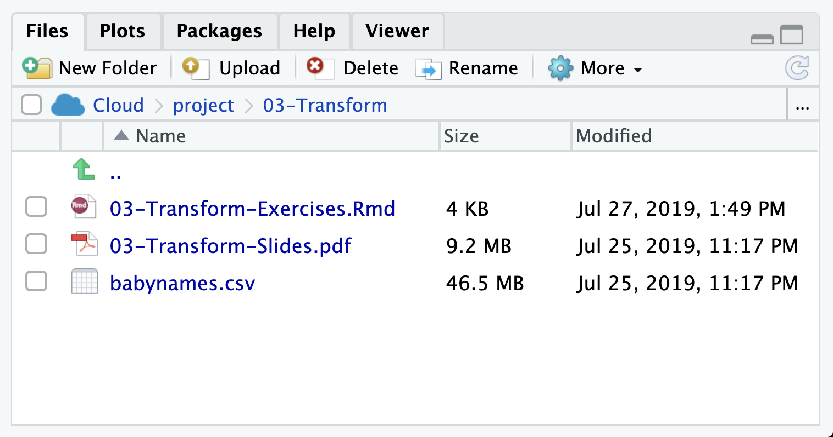
babynames.csv
Names and sex of babies born in the US from 1880 to 2017. 1.9M rows.

Slide 3
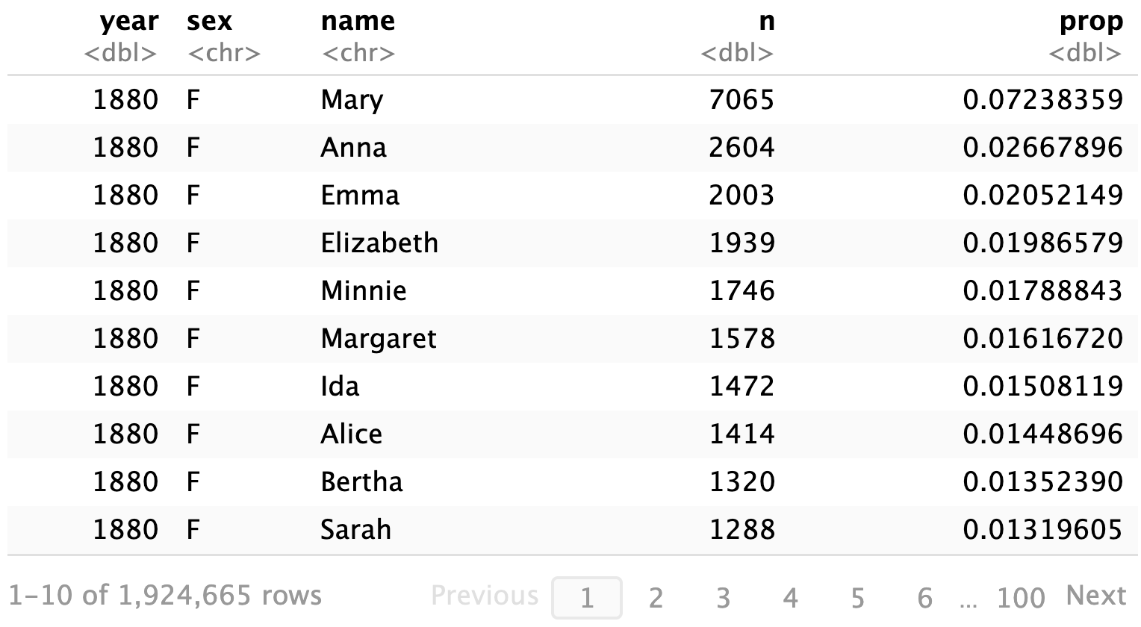
babynames

Slide 4
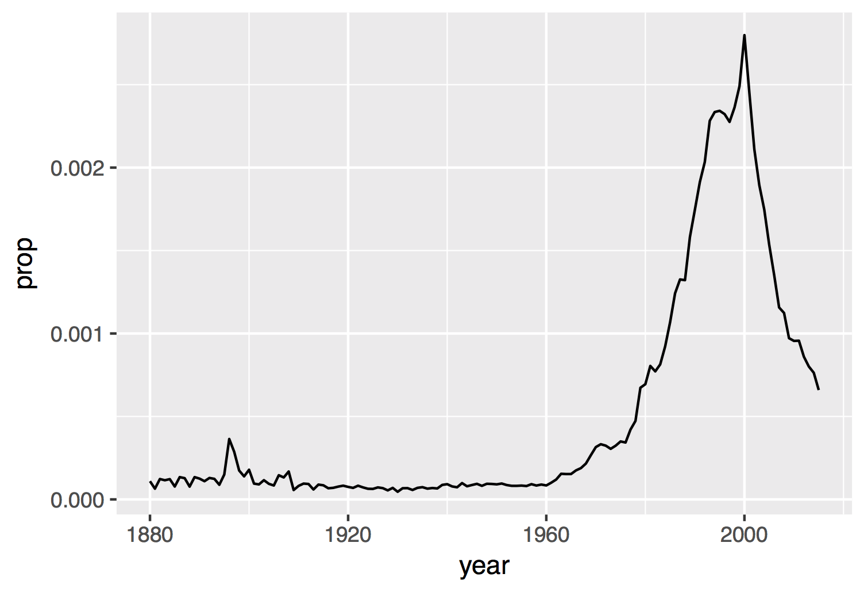
Proportion of boys with the name Garrett

Slide 5

(Applied) Data Science
Visualize
Import
Tidy
Model
Communicate
Transform
Program

Slide 6

Import data

Slide 7
babynames.csv
year,sex,name,n,prop
1880,F,Mary,7065,0.07238359
1880,F,Anna,2604,0.02667896
1880,F,Emma,2003,0.02052149
1880,F,Elizabeth,1939,0.01986579
1880,F,Minnie,1746,0.01788843
1880,F,Margaret,1578,0.0161672
1880,F,Ida,1472,0.01508119
1880,F,Alice,1414,0.01448696

Slide 8
babynames.csv
year,sex,name,n,prop
1880,F,Mary,7065,0.07238359
1880,F,Anna,2604,0.02667896
1880,F,Emma,2003,0.02052149
1880,F,Elizabeth,1939,0.01986579
1880,F,Minnie,1746,0.01788843
1880,F,Margaret,1578,0.0161672
1880,F,Ida,1472,0.01508119
1880,F,Alice,1414,0.01448696

Slide 9

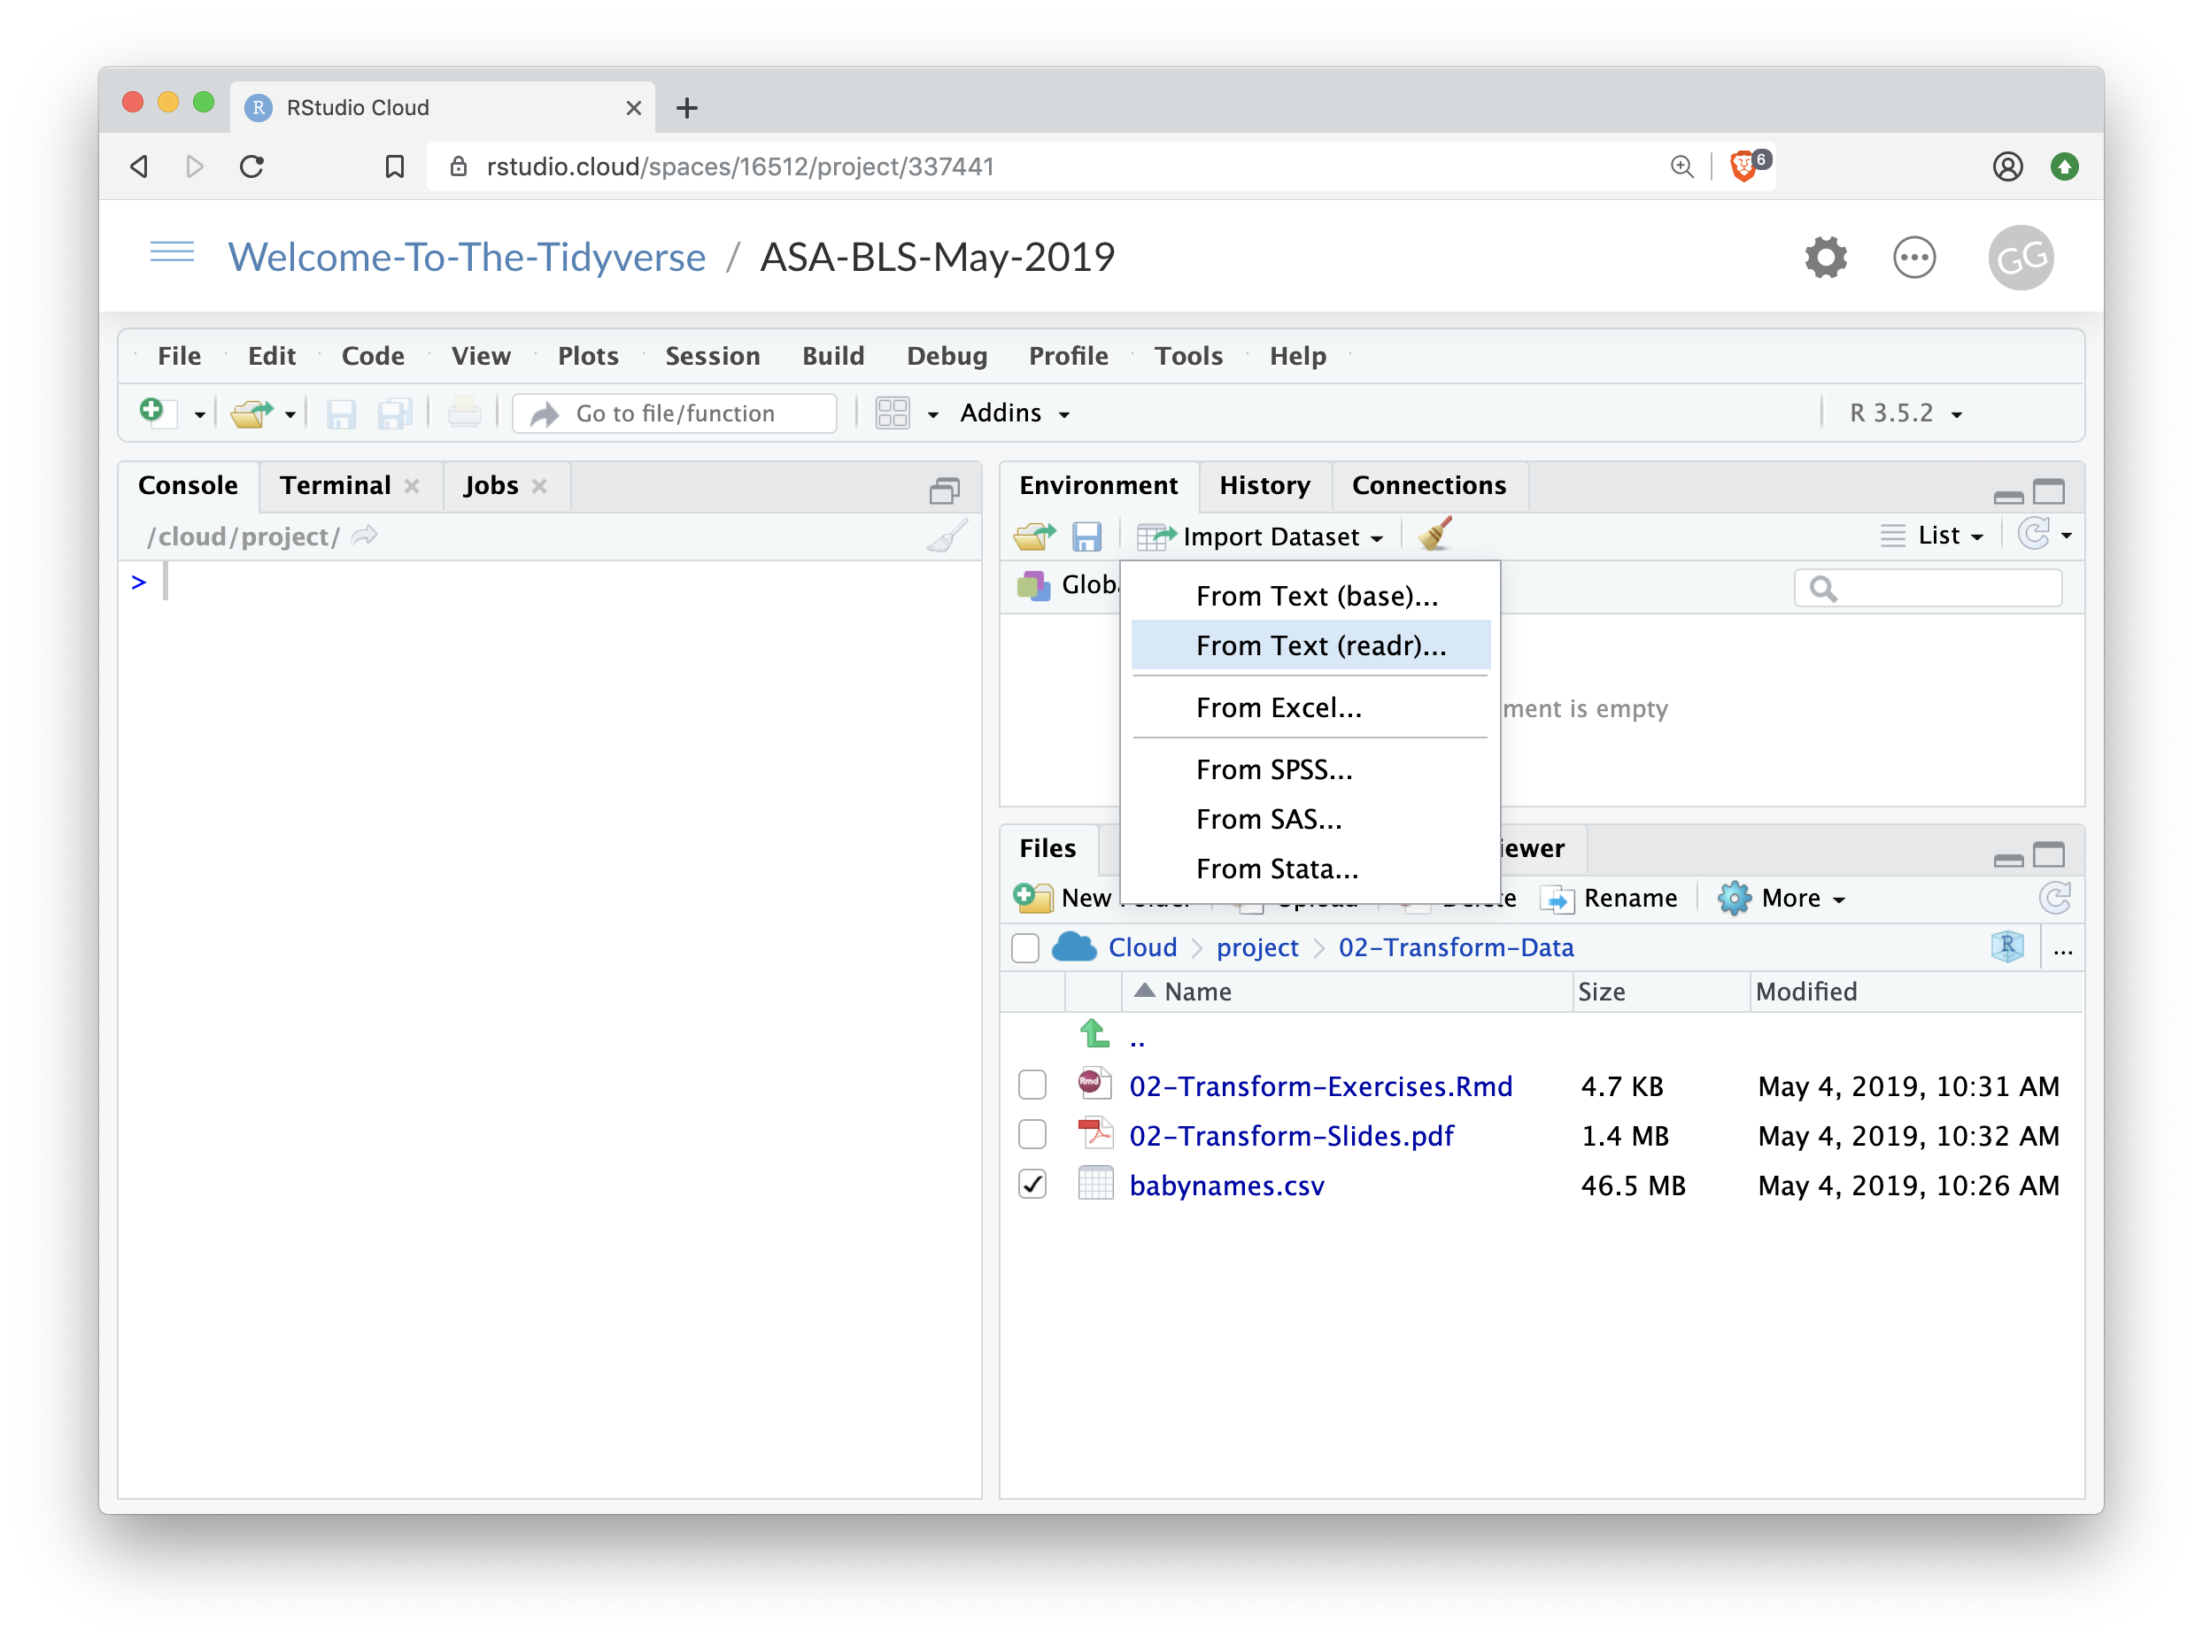

Import
Click Import Dataset From Text (readr)…

Slide 10
Pop Quiz
But is this reproducible?

Slide 11
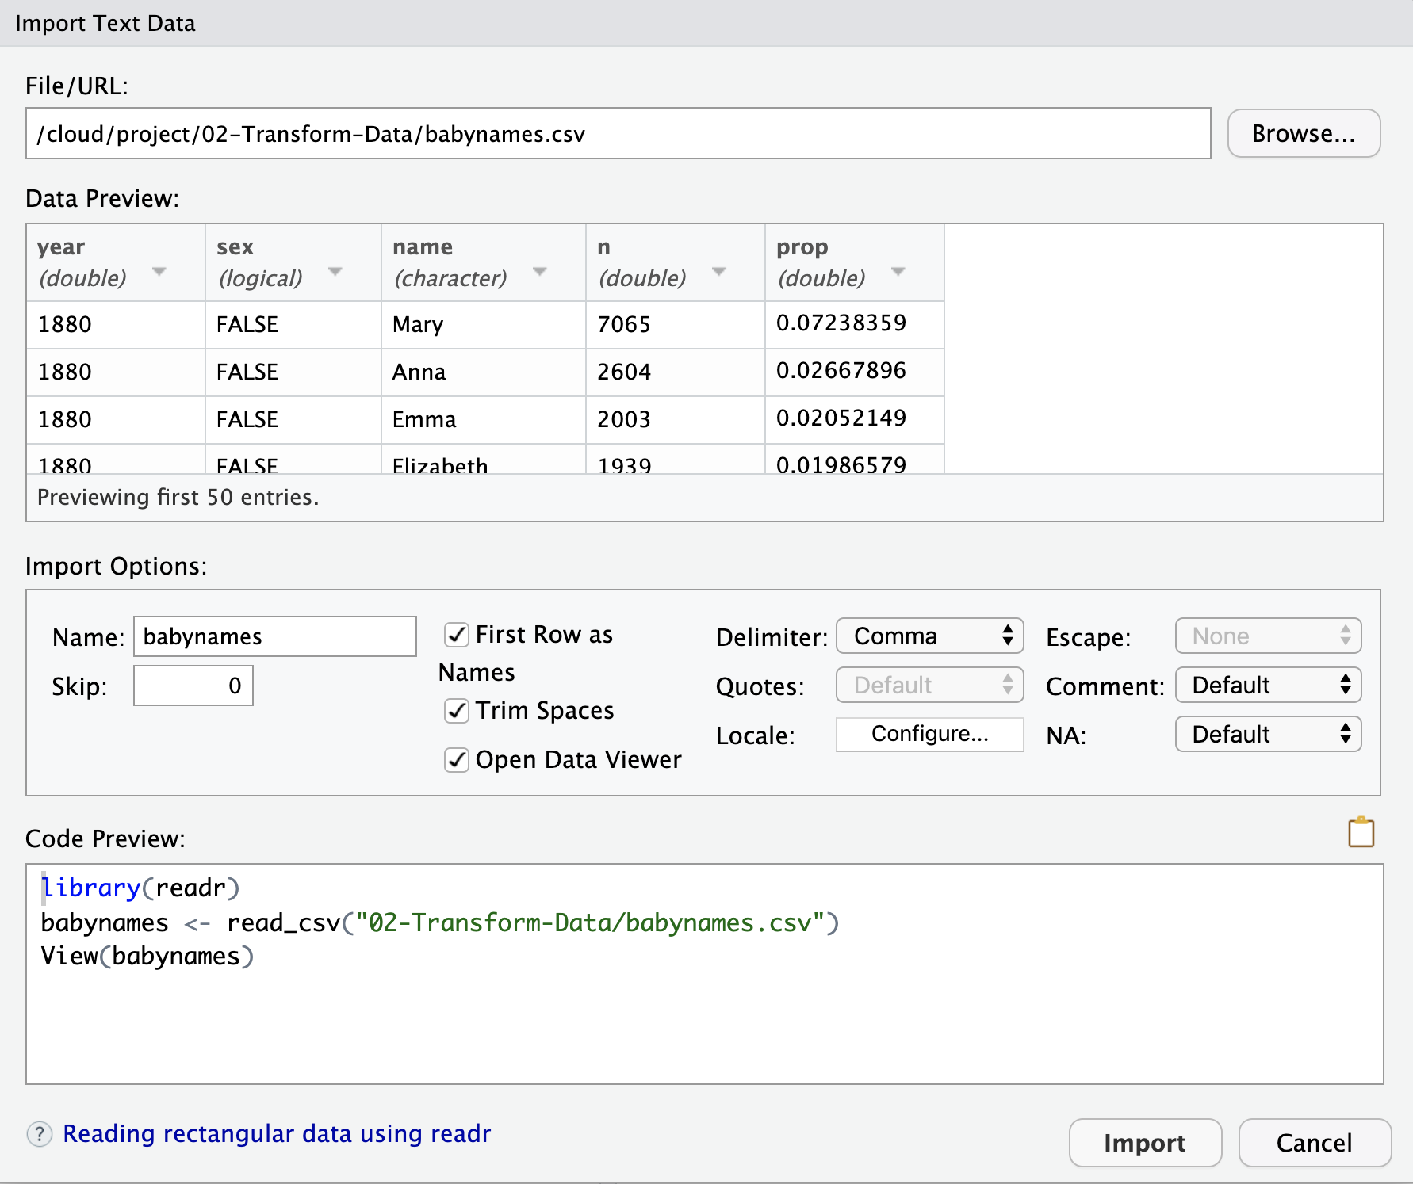

The Code Equivalent

Slide 12
Question
Where is the working directory when you press knit?

Slide 13

Your Turn 1
Move your working directory to the 03-Transform folder.
Import the babynames.csv dataset. Give it the name babynames.
Copy the import code into the code chunk in 03-Transform-Exercises (so the document can reload it later).

Slide 14
babynames
Names of male and female babies born in the US from 1880 to 2015. 1.8M rows.
R package
# install.packages("babynames")
library(babynames)

Slide 15

write_csv()
Saves data set as a csv on your computer.
write_csv(babynames, path = "babynames.csv")
Table to save
file
path to save at

Slide 16
(Applied) Data Science
Visualize
Import
Tidy
Model
Communicate
Transform
Program

Slide 17
babynames

Slide 18
Proportion of boys with the name Garrett
Which geom?

Slide 19
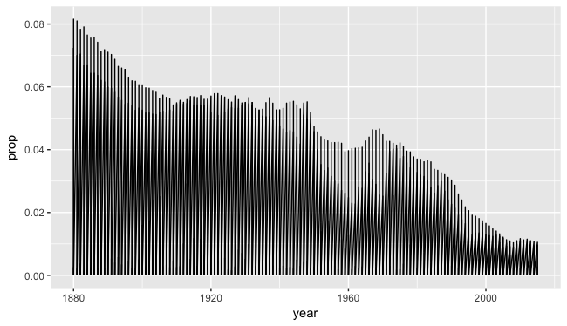
ggplot(data = babynames) +
geom_line(mapping = aes(x = year, y = prop))

Slide 20
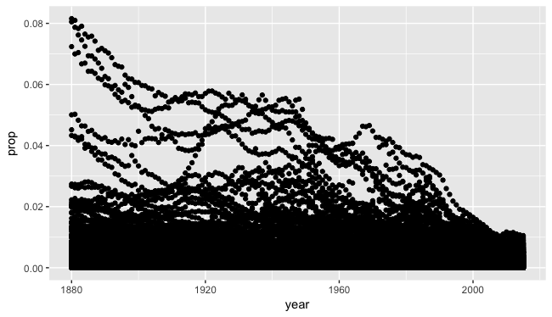
ggplot(data = babynames) +
geom_point(mapping = aes(x = year, y = prop))

Slide 21
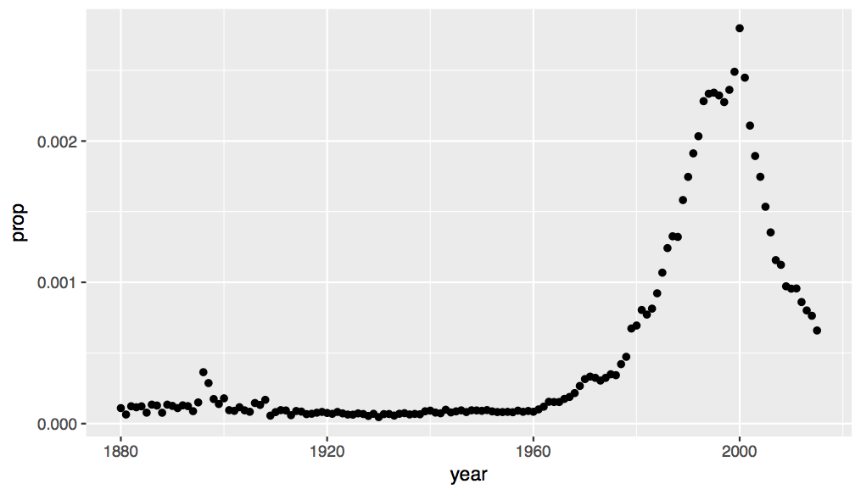
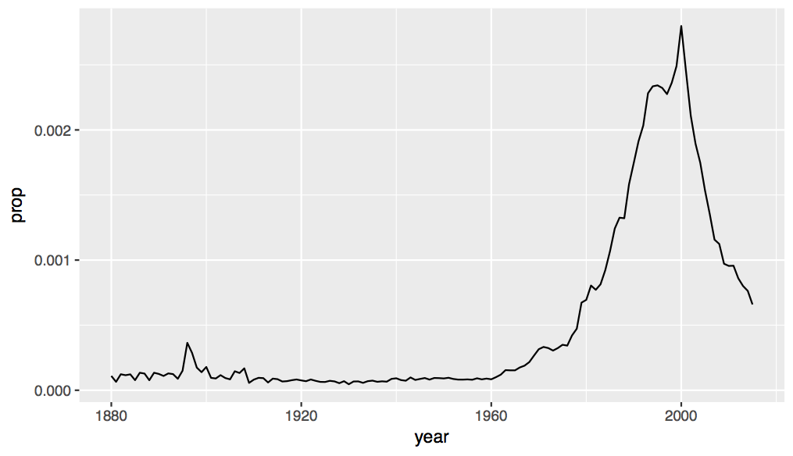

Slide 22
How to isolate?
year | sex | name | n | prop
1880 | M | John | 9655 | 0.0815
1880 | M | William | 9532 | 0.0805
1880 | M | James | 5927 | 0.0501
1880 | M | Charles | 5348 | 0.0451
1880 | M | Garrett | 13 | 0.0001
1881 | M | John | 8769 | 0.081
1881 | M | William | 8524 | 0.0787
1881 | M | James | 5442 | 0.0503
1881 | M | Charles | 4664 | 0.0431
1881 | M | Garrett | 7 | 0.0001
1881 | M | Gideon | 7 | 0.0001
year | sex | name | n | prop
1880 | M | Garrett | 13 | 0.0001
1881 | M | Garrett | 7 | 0.0001
… | … | Garrett | … | …

Slide 23
dplyr

Slide 24
dplyr
A package that transforms data.
dplyr implements a grammar for transforming tabular data.

Slide 25
Isolating data
select() - extract variables
filter() - extract cases
arrange() - reorder cases

Slide 26
select()

Slide 27
select()
Extract columns by name.
select(.data, …)
data frame to transform
name(s) of columns to extract
(or a select helper function)

Slide 28
select()
Extract columns by name.
select(babynames, name, prop)
babynames
year | sex | name | n | prop
1880 | M | John | 9655 | 0.0815
1880 | M | William | 9532 | 0.0805
1880 | M | James | 5927 | 0.0501
1880 | M | Charles | 5348 | 0.0451
1880 | M | Garrett | 13 | 0.0001
1881 | M | John | 8769 | 0.081
1881 | M | William | 8524 | 0.0787
1881 | M | James | 5442 | 0.0503
1881 | M | Charles | 4664 | 0.0431
1881 | M | Garrett | 7 | 0.0001
1881 | M | Gideon | 7 | 0.0001
name | prop
John | 0.0815
William | 0.0805
James | 0.0501
Charles | 0.0451
Garrett | 0.0001
John | 0.081
William | 0.0787
James | 0.0503
Charles | 0.0431
Garrett | 0.0001
Gideon | 0.0001

Slide 29

Your Turn 2
Alter the code to select just the n column:
select(babynames, name, prop)

Slide 30
select(babynames, n)
# n
# <int>
# 1 7065
# 2 2604
# 3 2003
# 4 1939
# 5 1746
# … …

Slide 31
select() helpers
: - Select range of columns
select(mpg, cty:class)
- - Select every column but
select(mpg, -c(cty, hwy))
starts_with() - Select columns that start with…
select(mpg, starts_with("c"))
ends_with() - Select columns that end with…
select(mpg, ends_with("y"))

Slide 32
select() helpers
contains() - Select columns whose names contain…
select(mpg, contains("d"))
matches() - Select columns whose names match regular expression
select(mpg, matches("^.{4}$"))
one_of() - Select columns whose names are one of a set
select(mpg, one_of(c("fl", "fuel", "Fuel"))
num_range() - Select columns named in prefix, number style
select(mpg, num_range("x", 1:5))

Slide 33
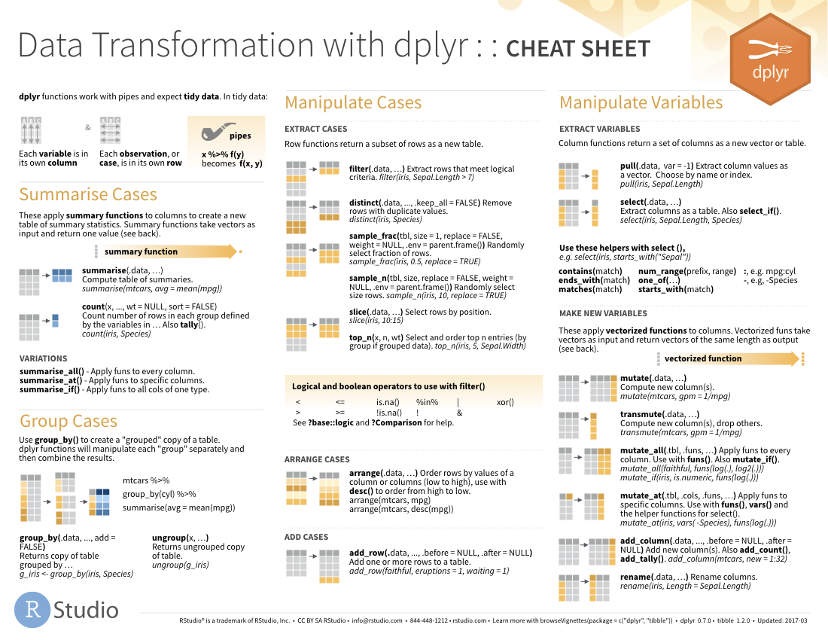
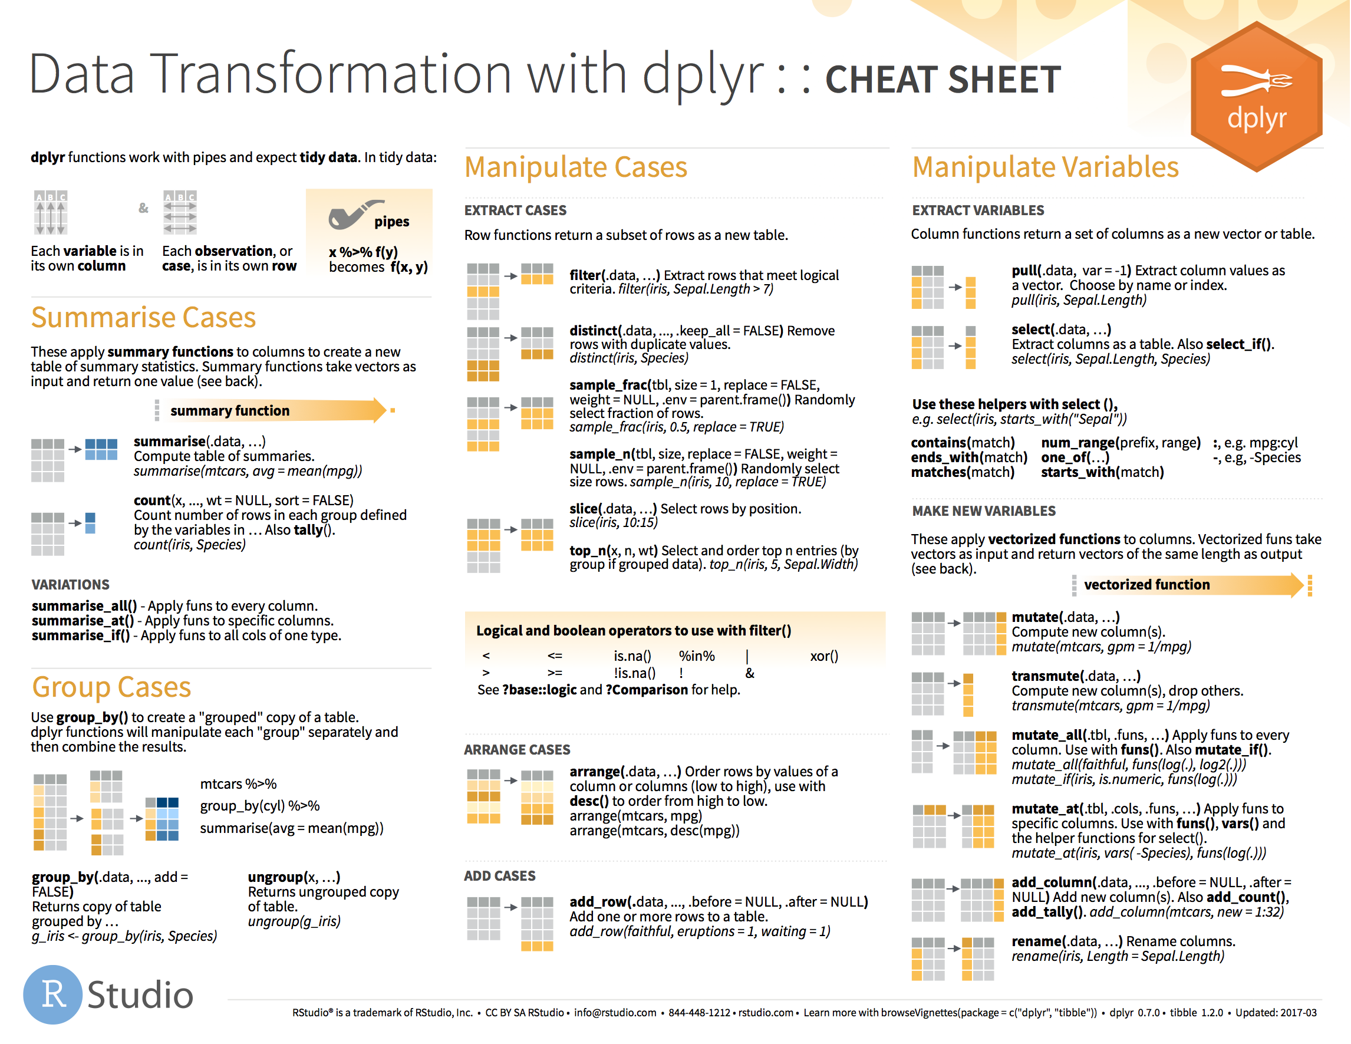
select() helpers

Slide 34
Quiz
Which of these is NOT a way to select the name and n columns together?
select(babynames, -c(year, sex, prop))
select(babynames, name:n)
select(babynames, starts_with("n"))
select(babynames, ends_with("n"))

Slide 35
Quiz
Which of these is NOT a way to select the name and n columns together?
select(babynames, -c(year, sex, prop))
select(babynames, name:n)
select(babynames, starts_with("n"))
select(babynames, ends_with("n"))

Slide 36
filter()

Slide 37
filter()
Extract rows that meet logical criteria.
filter(.data, … )
data frame to transform
one or more logical tests (filter returns each row for which the test is TRUE)

Slide 38
common syntax
Each function takes a data frame / tibble as its first argument and returns a data frame / tibble.
filter(.data, … )
dplyr function
function specific arguments
data frame to transform

Slide 39
filter()
Extract rows that meet logical criteria.
filter(babynames, name == "Garrett")
babynames
year | sex | name | n | prop
1880 | M | John | 9655 | 0.0815
1880 | M | William | 9532 | 0.0805
1880 | M | James | 5927 | 0.0501
1880 | M | Charles | 5348 | 0.0451
1880 | M | Garrett | 13 | 0.0001
1881 | M | John | 8769 | 0.081
1881 | M | William | 8524 | 0.0787
1881 | M | James | 5442 | 0.0503
1881 | M | Charles | 4664 | 0.0431
1881 | M | Garrett | 7 | 0.0001
1881 | M | Gideon | 7 | 0.0001
year | sex | name | n | prop
1880 | M | Garrett | 13 | 0.0001
1881 | M | Garrett | 7 | 0.0001
… | … | Garrett | … | …

Slide 40
filter()
Extract rows that meet logical criteria.
filter(babynames, name == "Garrett")
= sets
(returns nothing)
== tests if equal
(returns TRUE or FALSE)
babynames
year | sex | name | n | prop
1880 | M | John | 9655 | 0.0815
1880 | M | William | 9532 | 0.0805
1880 | M | James | 5927 | 0.0501
1880 | M | Charles | 5348 | 0.0451
1880 | M | Garrett | 13 | 0.0001
1881 | M | John | 8769 | 0.081
1881 | M | William | 8524 | 0.0787
1881 | M | James | 5442 | 0.0503
1881 | M | Charles | 4664 | 0.0431
1881 | M | Garrett | 7 | 0.0001
1881 | M | Gideon | 7 | 0.0001

Slide 41
Logical tests
?Comparison
x < y | Less than
x > y | Greater than
x == y | Equal to
x <= y | Less than or equal to
x >= y | Greater than or equal to
x != y | Not equal to
x %in% y | Group membership
is.na(x) | Is NA
!is.na(x) | Is not NA

Slide 42
x <- 1
x >= 2
# FALSE

Slide 43
x <- c(1, 2, 3)
x >= 2
# FALSE TRUE TRUE

Slide 44
Pop Quiz
What might NA stand for?
1
"1"
"one"
NA

Slide 45

Pop Quiz
What might NA stand for?
1
"1"
"one"
NA
Missing Value (Not Available)

Slide 46
Pop Quiz
What is the result?
1 == 1

Slide 47
Pop Quiz
What is the result?
1 == 1
TRUE

Slide 48
Pop Quiz
What is the result?
1 == NA

Slide 49
Pop Quiz
What is the result?
1 == NA
NA

Slide 50
Pop Quiz
What is the result?
NA == NA

Slide 51
Pop Quiz
What is the result?
NA == NA
NA

Slide 52
Pop Quiz
What is the result?
is.na(NA)
TRUE

Slide 53
Logical tests
?Comparison
x < y | Less than
x > y | Greater than
x == y | Equal to
x <= y | Less than or equal to
x >= y | Greater than or equal to
x != y | Not equal to
x %in% y | Group membership
is.na(x) | Is NA
!is.na(x) | Is not NA

Slide 54

Your Turn 3
Use filter, babynames, and the logical operators to find:
• All of the rows where prop is greater than or equal to 0.08
• All of the children named “Sea”

Slide 55
filter(babynames, prop >= 0.08)
# year sex name n prop
# 1 1880 M John 9655 0.08154630
# 2 1880 M William 9531 0.08049899
# 3 1881 M John 8769 0.08098299
filter(babynames, name == "Sea")
# year sex name n prop
# 1 1982 F Sea 5 2.756771e-06
# 2 1985 M Sea 6 3.119547e-06
# 3 1986 M Sea 5 2.603512e-06
# 4 1998 F Sea 5 2.580377e-06

Slide 56
Two common mistakes
1. Using = instead of ==
filter(babynames, name = "Sea")
filter(babynames, name == "Sea")
2. Forgetting quotes
filter(babynames, name == Sea)
filter(babynames, name == "Sea")

Slide 57
filter()
Extract rows that meet every logical criteria.
filter(babynames, name == "Garrett", year == 1880)
babynames
year | sex | name | n | prop
1880 | M | John | 9655 | 0.0815
1880 | M | William | 9532 | 0.0805
1880 | M | James | 5927 | 0.0501
1880 | M | Charles | 5348 | 0.0451
1880 | M | Garrett | 13 | 0.0001
1881 | M | John | 8769 | 0.081
1881 | M | William | 8524 | 0.0787
1881 | M | James | 5442 | 0.0503
1881 | M | Charles | 4664 | 0.0431
1881 | M | Garrett | 7 | 0.0001
1881 | M | Gideon | 7 | 0.0001
year | sex | name | n | prop
1880 | M | Garrett | 13 | 0.0001

Slide 58
filter()
Extract rows that meet every logical criteria.
filter(babynames, name == "Garrett" & year == 1880)
babynames
year | sex | name | n | prop
1880 | M | John | 9655 | 0.0815
1880 | M | William | 9532 | 0.0805
1880 | M | James | 5927 | 0.0501
1880 | M | Charles | 5348 | 0.0451
1880 | M | Garrett | 13 | 0.0001
1881 | M | John | 8769 | 0.081
1881 | M | William | 8524 | 0.0787
1881 | M | James | 5442 | 0.0503
1881 | M | Charles | 4664 | 0.0431
1881 | M | Garrett | 7 | 0.0001
1881 | M | Gideon | 7 | 0.0001
year | sex | name | n | prop
1880 | M | Garrett | 13 | 0.0001

Slide 59
Boolean operators
?base::Logic
a & b | and
a | b | or
xor(a,b) | exactly or
!a | not
( ) | To group tests . & evaluates before |

Slide 60
x >= 2 & x < 3
TRUE & TRUE
TRUE

Slide 61

Your Turn 4
Use Boolean operators to alter the code below to return only the rows that contain:
• Boys named Sue
• Names that were used by exactly 5 or 6 children in 1880
• Names that are one of Acura, Lexus, or Yugo
filter(babynames, name == "Sea" | name == "Anemone")

Slide 62
filter(babynames, name == "Sue", sex == "M")
# year sex name n prop
# 1 1917 M Sue 7 0.0000073
# 2 1927 M Sue 5 0.0000043
# … … … … … …
filter(babynames, (n == 5 | n == 6) & year == 1880)
# year sex name n prop
# 1 1880 F Abby 6 6.147289e-05
# 2 1880 F Aileen 6 6.147289e-05
# … … … … … …
Parentheses matter
filter(babynames, name == "Acura" | name =="Lexus" |name =="Yugo")
# year sex name n prop
# 1 1990 F Lexus 36 1.752932e-05
# 2 1990 M Lexus 12 5.579156e-06
# … … … … … …

Slide 63
Two more common mistakes
3. Collapsing multiple tests into one
filter(babynames, 10 < n < 20)
filter(babynames, 10 < n, n < 20)
4. Stringing together many tests (when you could use %in%)
filter(babynames, n == 5 | n == 6 | n == 7 | n == 8)
filter(babynames, n %in% c(5, 6, 7, 8))

Slide 64
filter(babynames, name == "Sue", sex == "M")
# year sex name n prop
# 1 1917 M Sue 7 0.0000073
# 2 1927 M Sue 5 0.0000043
# … … … … … …
filter(babynames, (n == 5 | n == 6) & year == 1880)
# year sex name n prop
# 1 1880 F Abby 6 6.147289e-05
# 2 1880 F Aileen 6 6.147289e-05
# … … … … … …
filter(babynames, name == "Acura" | name =="Lexus" |name =="Yugo")
# year sex name n prop
# 1 1990 F Lexus 36 1.752932e-05
# 2 1990 M Lexus 12 5.579156e-06
# … … … … … …

Slide 65
arrange()

Slide 66
arrange()
Order rows from smallest to largest values.
arrange(.data, …)
data frame to transform
one or more columns to order by
(additional columns will be used as tie breakers)

Slide 67
arrange()
Order rows from smallest to largest values.
arrange(babynames, n)
babynames
year | sex | name | n | prop
1880 | M | John | 9655 | 0.0815
1880 | M | William | 9532 | 0.0805
1880 | M | James | 5927 | 0.0501
1880 | M | Charles | 5348 | 0.0451
1880 | M | Garrett | 13 | 0.0001
1881 | M | John | 8769 | 0.081
1881 | M | William | 8524 | 0.0787
1881 | M | James | 5442 | 0.0503
1881 | M | Charles | 4664 | 0.0431
1881 | M | Garrett | 7 | 0.0001
1881 | M | Gideon | 7 | 0.0001
year | sex | name | n | prop
1880 | M | Garrett | 13 | 0.0001
1880 | M | Charles | 5348 | 0.0451
1880 | M | James | 5927 | 0.0501
1881 | M | John | 8769 | 0.081
1880 | M | William | 9532 | 0.0805
1880 | M | John | 9655 | 0.0815
1881 | M | William | 8524 | 0.0787
1881 | M | James | 5442 | 0.0503
1881 | M | Charles | 4664 | 0.0431
1881 | M | Garrett | 7 | 0.0001
1881 | M | Gideon | 7 | 0.0001

Slide 68
desc()
Changes ordering to largest to smallest.
arrange(babynames, desc(n))
babynames
year | sex | name | n | prop
1880 | M | John | 9655 | 0.0815
1880 | M | William | 9532 | 0.0805
1880 | M | James | 5927 | 0.0501
1880 | M | Charles | 5348 | 0.0451
1880 | M | Garrett | 13 | 0.0001
1881 | M | John | 8769 | 0.081
1881 | M | William | 8524 | 0.0787
1881 | M | James | 5442 | 0.0503
1881 | M | Charles | 4664 | 0.0431
1881 | M | Garrett | 7 | 0.0001
1881 | M | Gideon | 7 | 0.0001
year | sex | name | n | prop
1880 | M | John | 9655 | 0.0815
1880 | M | William | 9532 | 0.0805
1881 | M | John | 8769 | 0.081
1880 | M | James | 5927 | 0.0501
1880 | M | Charles | 5348 | 0.0451
1880 | M | Garrett | 13 | 0.0001
1881 | M | William | 8524 | 0.0787
1881 | M | James | 5442 | 0.0503
1881 | M | Charles | 4664 | 0.0431
1881 | M | Garrett | 7 | 0.0001
1881 | M | Gideon | 7 | 0.0001

Slide 69
Help me
What is the smallest value of n?
What is the largest?

Slide 70
arrange(babynames, n, prop)
# year sex name n prop
# 1 2007 M Aaban 5 2.259872e-06
# 2 2007 M Aareon 5 2.259872e-06
# 3 2007 M Aaris 5 2.259872e-06
# 4 2007 M Abd 5 2.259872e-06
# 5 2007 M Abdulazeez 5 2.259872e-06
# 6 2007 M Abdulhadi 5 2.259872e-06
# 7 2007 M Abdulhamid 5 2.259872e-06
# 8 2007 M Abdulkadir 5 2.259872e-06
# 9 2007 M Abdulraheem 5 2.259872e-06
# 10 2007 M Abdulrahim 5 2.259872e-06
# … with 1,924,655 more rows

Slide 71
arrange(babynames, desc(n))
# year sex name n prop
# 1 1947 F Linda 99680 0.05483609
# 2 1948 F Linda 96211 0.05521159
# 3 1947 M James 94763 0.05102057
# 4 1957 M Michael 92726 0.04238659
# 5 1947 M Robert 91646 0.04934237
# 6 1949 F Linda 91010 0.05184281
# 7 1956 M Michael 90623 0.04225479
# 8 1958 M Michael 90517 0.04203881
# 9 1948 M James 88588 0.04969679
# 10 1954 M Michael 88493 0.04279403
# … with 1,924,655 more rows

Slide 72
arrange(babynames, desc(prop))
# year sex name n prop
# 1 1880 M John 9655 0.08154630
# 2 1881 M John 8769 0.08098299
# 3 1880 M William 9531 0.08049899
# 4 1883 M John 8894 0.07907324
# 5 1881 M William 8524 0.07872038
# 6 1882 M John 9557 0.07831617
# 7 1884 M John 9388 0.07648751
# 8 1882 M William 9298 0.07619375
# 9 1886 M John 9026 0.07582198
# 10 1885 M John 8756 0.07551791
# ... with 1,858,679 more rows
arrange(babynames, desc(n))
# year sex name n prop
# 1 1947 F Linda 99680 0.05483609
# 2 1948 F Linda 96211 0.05521159
# 3 1947 M James 94763 0.05102057
# 4 1957 M Michael 92726 0.04238659
# 5 1947 M Robert 91646 0.04934237
# 6 1949 F Linda 91010 0.05184281
# 7 1956 M Michael 90623 0.04225479
# 8 1958 M Michael 90517 0.04203881
# 9 1948 M James 88588 0.04969679
# 10 1954 M Michael 88493 0.04279403
# ... with 1,858,679 more rows

Slide 73

Your Turn 5
What was the most popular name in a single year? Use desc() and arrange() to find:
the highest n
the highest prop

Slide 74
%>%

Slide 75
Steps
boys_2015 <- filter(babynames, year == 2015, sex == "M")
boys_2015 <- select(boys_2015, name, n)
boys_2015 <- arrange(boys_2015, desc(n))
boys_2015
1. Filter babynames to just boys born in 2015
2. Select the name and n columns from the result
3. Arrange those columns so that the most popular names appear near the top.

Slide 76
Steps
boys_2015 <- filter(babynames, year == 2015, sex == "M")
boys_2015 <- select(boys_2015, name, n)
boys_2015 <- arrange(boys_2015, desc(n))
boys_2015

Slide 77
Steps
arrange(select(filter(babynames, year == 2015,
sex == "M"), name, n), desc(n))

Slide 78
The pipe operator %>%
%>%
babynames %>% filter( , n == 99680)
Passes result on left into first argument of function on right.
So, for example, these do the same thing. Try it.
filter(babynames, n == 99680)
babynames %>% filter(n == 99680)

Slide 79
Pipes
babynames
boys_2015 <- filter(babynames, year == 2015, sex == "M")
boys_2015 <- select(boys_2015, name, n)
boys_2015 <- arrange(boys_2015, desc(n))
boys_2015
babynames %>%
filter(year == 2015, sex == "M") %>%
select(name, n) %>%
arrange(desc(n))

Slide 80
foo_foo <- little_bunny()
foo_foo %>%
hop_through(forest) %>%
scoop_up(field_mouse) %>%
bop_on(head)
vs.
foo_foo2 <- hop_through(foo_foo, forest)
foo_foo3 <- scoop_up(foo_foo2, field_mouse)
bop_on(foo_foo3, head)

Slide 81
Shortcut to type %>%
Cmd
+
Shift
+
M
(Mac)
Ctrl
+
Shift
+
M
(Windows)

Slide 82

Your Turn 5
Use %>% to write a sequence of functions that:
Filters babynames to the girls that were born in 2017, then…
Selects the name and n columns, then…
Arranges the results so that the most popular names are near the top.

Slide 83
babynames %>%
filter(year == 2017, sex == "F") %>%
select(name, n) %>%
arrange(desc(n))
# name n
# 1 Emma 19738
# 2 Olivia 18632
# 3 Ava 15902
# 4 Isabella 15100
# 5 Sophia 14831
# 6 Mia 13437
# 7 Charlotte 12893
# 8 Amelia 11800
# 9 Evelyn 10675
## … with 20,170 more rows

Slide 84
Payoff!

Slide 85
Your Turn 6 - Exam
Trim babynames to just the rows that contain your name and your sex
Trim the result to just the columns that will appear in your graph (not strictly necessary, but useful practice)
Plot the results as a line graph with year on the x axis and prop on the y axis

Slide 86
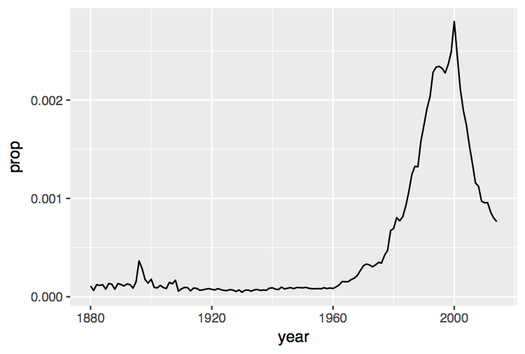
babynames %>%
filter(name == "Garrett", sex == "M") %>%
select(year, prop) %>%
ggplot() +
geom_line(mapping = aes(year, prop))

Slide 87
Plotting groups

Slide 88

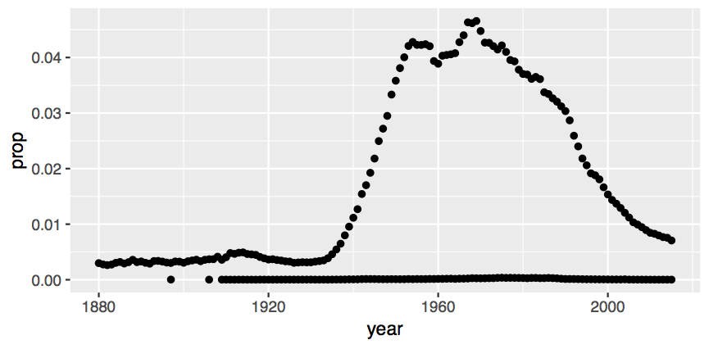
babynames %>%
filter(name == "Michael") %>%
ggplot() +
geom_point(mapping = aes(year, prop))
Did not filter on SEX

Slide 89
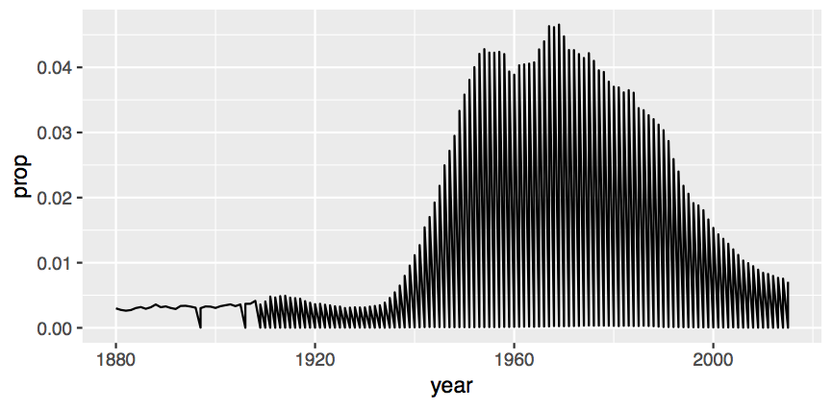
babynames %>%
filter(name == "Michael") %>%
ggplot() +
geom_line(mapping = aes(year, prop))

Slide 90
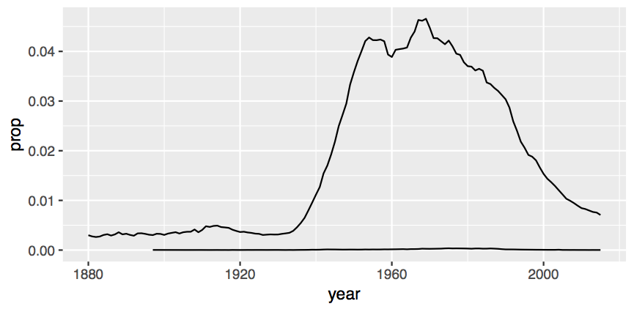
babynames %>%
filter(name == "Michael") %>%
ggplot() +
geom_line(mapping = aes(year, prop, group = sex))

Slide 91
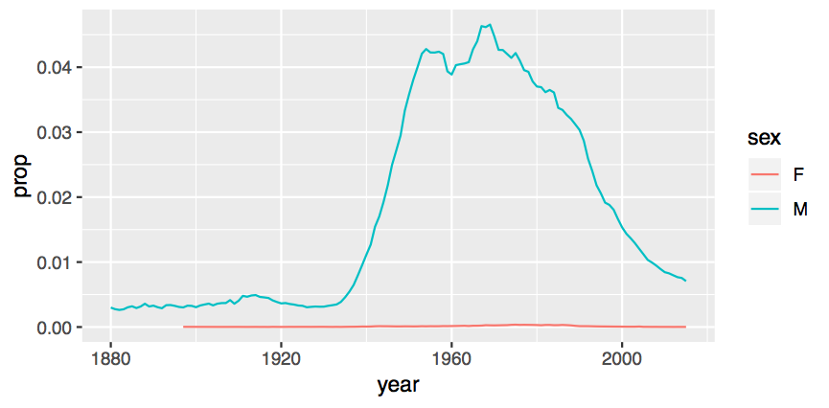
babynames %>%
filter(name == "Michael") %>%
ggplot() +
geom_line(mapping = aes(year, prop, color = sex))

Slide 92
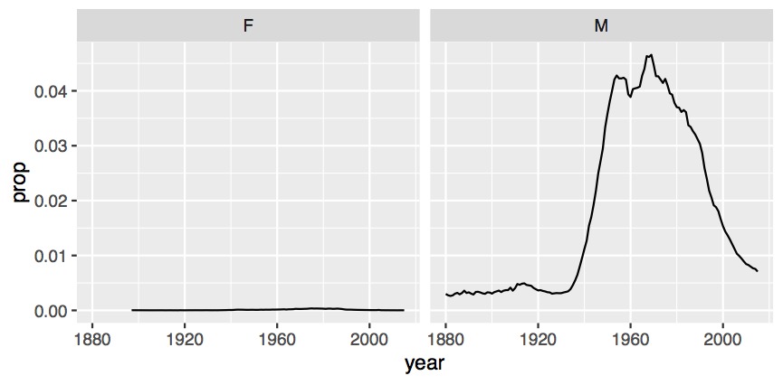
babynames %>% filter(name == "Michael") %>%
ggplot() +
geom_line(mapping = aes(year, prop)) +
facet_wrap(~ sex)

Slide 93
What are the most popular names?

Slide 94
Quiz
Do we have enough information to:
Calculate the total number of children with each name?

Slide 95
Deriving information
summarise() - summarise variables
group_by() - group cases
mutate() - create new variables

Slide 96
summarise()

Slide 97
summarise()
Compute table of summaries.
babynames %>% summarise(total = sum(n), max = max(n))
babynames
year | sex | name | n | prop
1880 | M | John | 9655 | 0.0815
1880 | M | William | 9532 | 0.0805
1880 | M | James | 5927 | 0.0501
1880 | M | Charles | 5348 | 0.0451
1880 | M | Garrett | 13 | 0.0001
1881 | M | John | 8769 | 0.081
1881 | M | William | 8524 | 0.0787
1881 | M | James | 5442 | 0.0503
1881 | M | Charles | 4664 | 0.0431
1881 | M | Garrett | 7 | 0.0001
1881 | M | Gideon | 7 | 0.0001
total | max
348120517 | 99686

Slide 98

Your Turn 7
Complete the code to extract the rows where name == "Khaleesi". Then use summarise() and sum() and min() to find:
The total number of children named Khaleesi
The first year Khaleesi appeared in the data

Slide 99
babynames %>%
filter(name == "Khaleesi") %>%
summarise(total = sum(n), first = min(year))
# total first
# 1 1964 2011

Slide 100
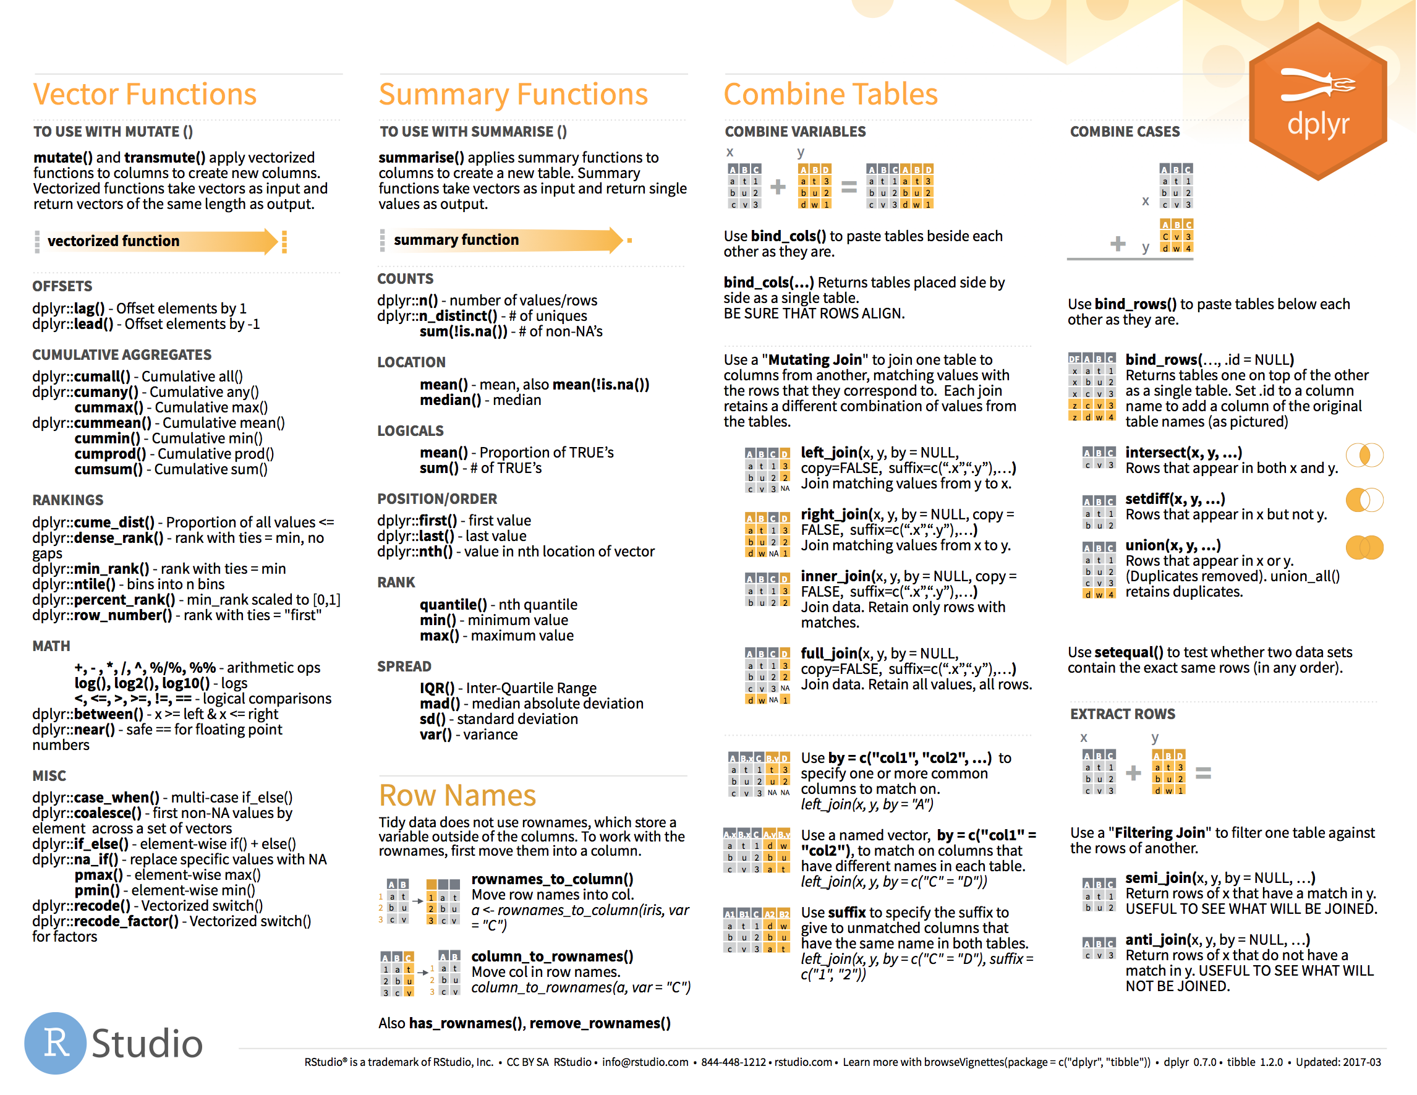
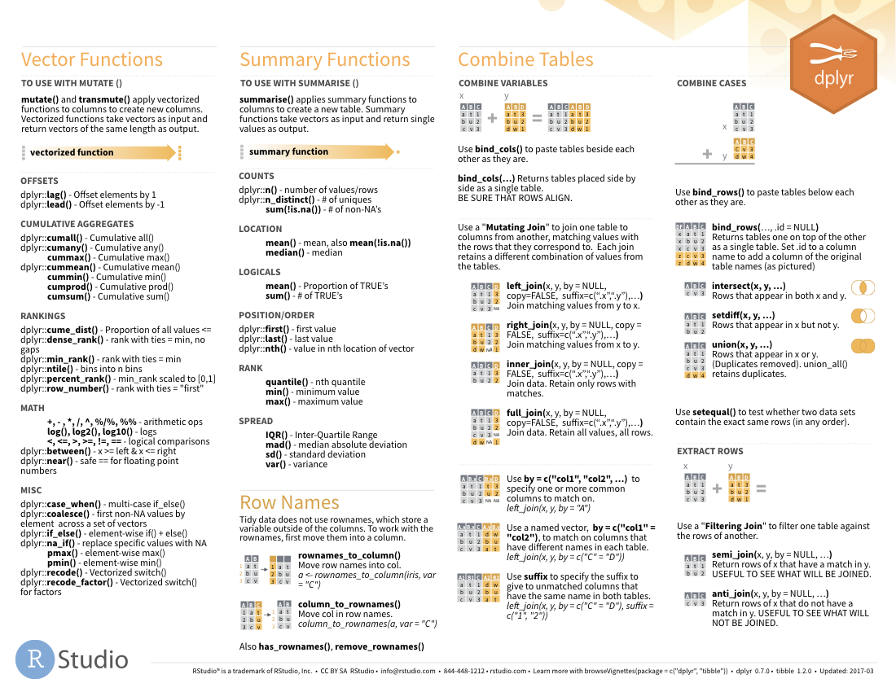

Summary functions
Take a vector as input.
Return a single value as output.
on back

Slide 101
n()
The number of rows in a dataset/group
babynames %>% summarise(n = n())
babynames
year | sex | name | n | prop
1880 | M | John | 9655 | 0.0815
1880 | M | William | 9532 | 0.0805
1880 | M | James | 5927 | 0.0501
1880 | M | Charles | 5348 | 0.0451
1880 | M | Garrett | 13 | 0.0001
1881 | M | John | 8769 | 0.081
1881 | M | William | 8524 | 0.0787
1881 | M | James | 5442 | 0.0503
1881 | M | Charles | 4664 | 0.0431
1881 | M | Garrett | 7 | 0.0001
1881 | M | Gideon | 7 | 0.0001
n
1924665

Slide 102
n_distinct()
The number of distinct values in a variable
babynames %>% summarise(n = n(), nname = n_distinct(name))
babynames
year | sex | name | n | prop
1880 | M | John | 9655 | 0.0815
1880 | M | William | 9532 | 0.0805
1880 | M | James | 5927 | 0.0501
1880 | M | Charles | 5348 | 0.0451
1880 | M | Garrett | 13 | 0.0001
1881 | M | John | 8769 | 0.081
1881 | M | William | 8524 | 0.0787
1881 | M | James | 5442 | 0.0503
1881 | M | Charles | 4664 | 0.0431
1881 | M | Garrett | 7 | 0.0001
1881 | M | Gideon | 7 | 0.0001
n | nname
1924665 | 97310

Slide 103
How should we define popularity?
A name is popular if:
Sums - a large number of children have the name when you sum across years
Ranks - it consistently ranks among the top names from year to year.

Slide 104
babynames %>%
filter(name == "Khaleesi" & sex == "F")
## year sex name n prop
## 1 2011 F Khaleesi 28 0.0000145
## 2 2012 F Khaleesi 146 0.0000754
## 3 2013 F Khaleesi 243 0.000126
## 4 2014 F Khaleesi 369 0.000189
## 5 2015 F Khaleesi 341 0.000175
## 6 2016 F Khaleesi 371 0.000192
## 7 2017 F Khaleesi 466 0.000249

Slide 105
babynames %>%
filter(name == "Khaleesi" & sex == "F") %>%
summarise(total = sum(n))
## total
## 1 1964
Can we do this for
each name?

Slide 106
Grouping
cases

Slide 107
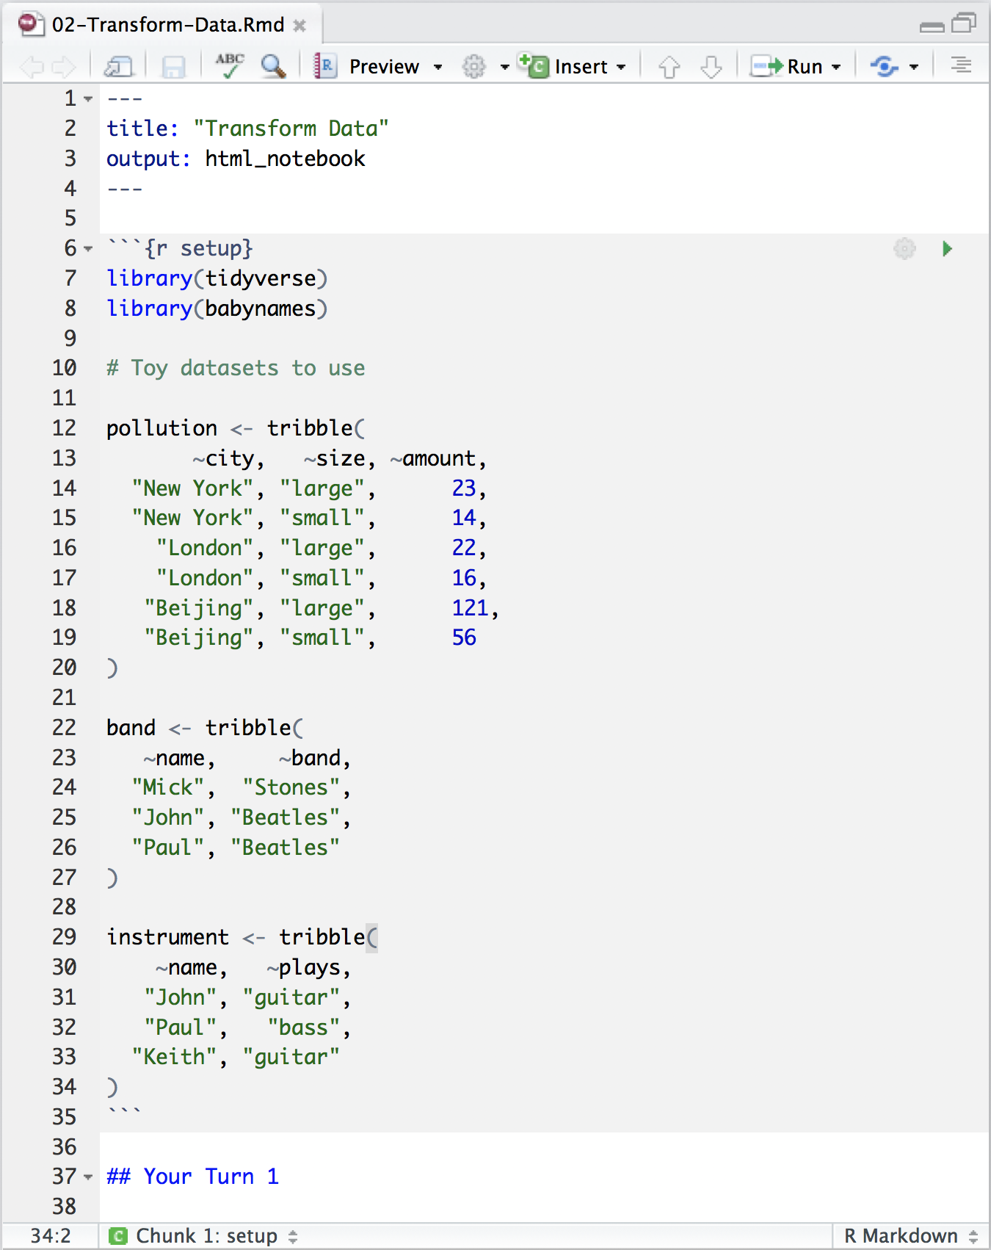
03-Transform-Exercises.Rmd
Toy data sets to practice with

Slide 108
pollution
city | particle size | amount (µg/m³)
New York | large | 23
New York | small | 14
London | large | 22
London | small | 16
Beijing | large | 121
Beijing | small | 56

Slide 109
city | particle size | amount (µg/m³)
New York | large | 23
New York | small | 14
London | large | 22
London | small | 16
Beijing | large | 121
Beijing | small | 56
mean | sum | n
42 | 252 | 6
pollution %>%
summarise(mean = mean(amount), sum = sum(amount), n = n())

Slide 110
city | particle size | amount (µg/m³)
New York | large | 23
New York | small | 14
London | large | 22
London | small | 16
Beijing | large | 121
Beijing | small | 56
mean | sum | n
42 | 252 | 6

Slide 111
city | particle size | amount (µg/m³)
New York | large | 23
New York | small | 14
mean | sum | n
42 | 252 | 6
London | large | 22
London | small | 16
Beijing | large | 121
Beijing | small | 56

Slide 112
city | particle size | amount (µg/m³)
New York | large | 23
New York | small | 14
mean | sum | n
18.5 | 37 | 2
mean | sum | n
18.5 | 37 | 2
London | large | 22
London | small | 16
19.0 | 38 | 2
19.0 | 38 | 2
Beijing | large | 121
Beijing | small | 56
88.5 | 177 | 2
88.5 | 177 | 2
group_by() + summarise()

Slide 113
group_by()
Groups cases by common values of one or more columns.
pollution %>%
group_by(city)
babynames %>% group_by(sex)
# A tibble: 6 x 3
# Groups: city [3]
city size amount
<chr> <chr> <dbl>
1 New York large 23
2 New York small 14
3 London large 22
4 London small 16
5 Beijing large 121
6 Beijing small 56

Slide 114
group_by()
city | particle size | amount (µg/m³)
New York | large | 23
New York | small | 14
city | particle size | amount (µg/m³)
New York | large | 23
New York | small | 14
city | mean | sum | n
New York | 18.5 | 37 | 2
London | 19.0 | 38 | 2
Beijing | 88.5 | 177 | 2
London | large | 22
London | small | 16
London | large | 22
London | small | 16
Beijing | large | 121
Beijing | small | 56
Beijing | large | 121
Beijing | small | 56
pollution %>%
group_by(city) %>%
summarise(mean = mean(amount), sum = sum(amount), n = n())

Slide 115
group_by()
city | particle size | amount (µg/m³)
New York | large | 23
city | particle size | amount (µg/m³)
New York | large | 23
New York | small | 14
city | particle size | mean | sum | n
New York | large | 23 | 23 | 1
New York | small | 14 | 14 | 1
London | large | 22 | 22 | 1
London | small | 16 | 16 | 1
Beijing | large | 121 | 121 | 1
Beijing | small | 56 | 56 | 1
New York | small | 14
London | large | 22
London | large | 22
London | small | 16
London | small | 16
Beijing | large | 121
Beijing | small | 56
Beijing | large | 121
Beijing | small | 56
pollution %>%
group_by(city, size) %>%
summarise(mean = mean(amount), sum = sum(amount), n = n())

Slide 116
group_by()
Groups cases by common values.
babynames %>%
group_by(sex) %>%
summarise(total = sum(n))
sex | total
F | 172371079
M | 175749438

Slide 117
ungroup()
Removes grouping criteria from a data frame.
babynames %>%
group_by(sex) %>%
ungroup() %>%
summarise(total = sum(n))
total
348120517

Slide 118
Your Turn 8
Complete the code with group_by(), summarise(), and arrange() to display the ten most popular name and sex combinations. Compute popularity as the total number of children with a given name and sex.

Slide 119
babynames %>%
group_by(name, sex) %>%
summarise(total = sum(n)) %>%
arrange(desc(total))
# name sex total
# 1 James M 5120990
# 2 John M 5095674
# 3 Robert M 4803068
# 4 Michael M 4323928
# 5 Mary F 4118058
# 6 William M 4071645
# 7 David M 3589754
# 8 Joseph M 2581785
# 9 Richard M 2558165
# 10 Charles M 2371621
# … with 107,963 more rows

Slide 120
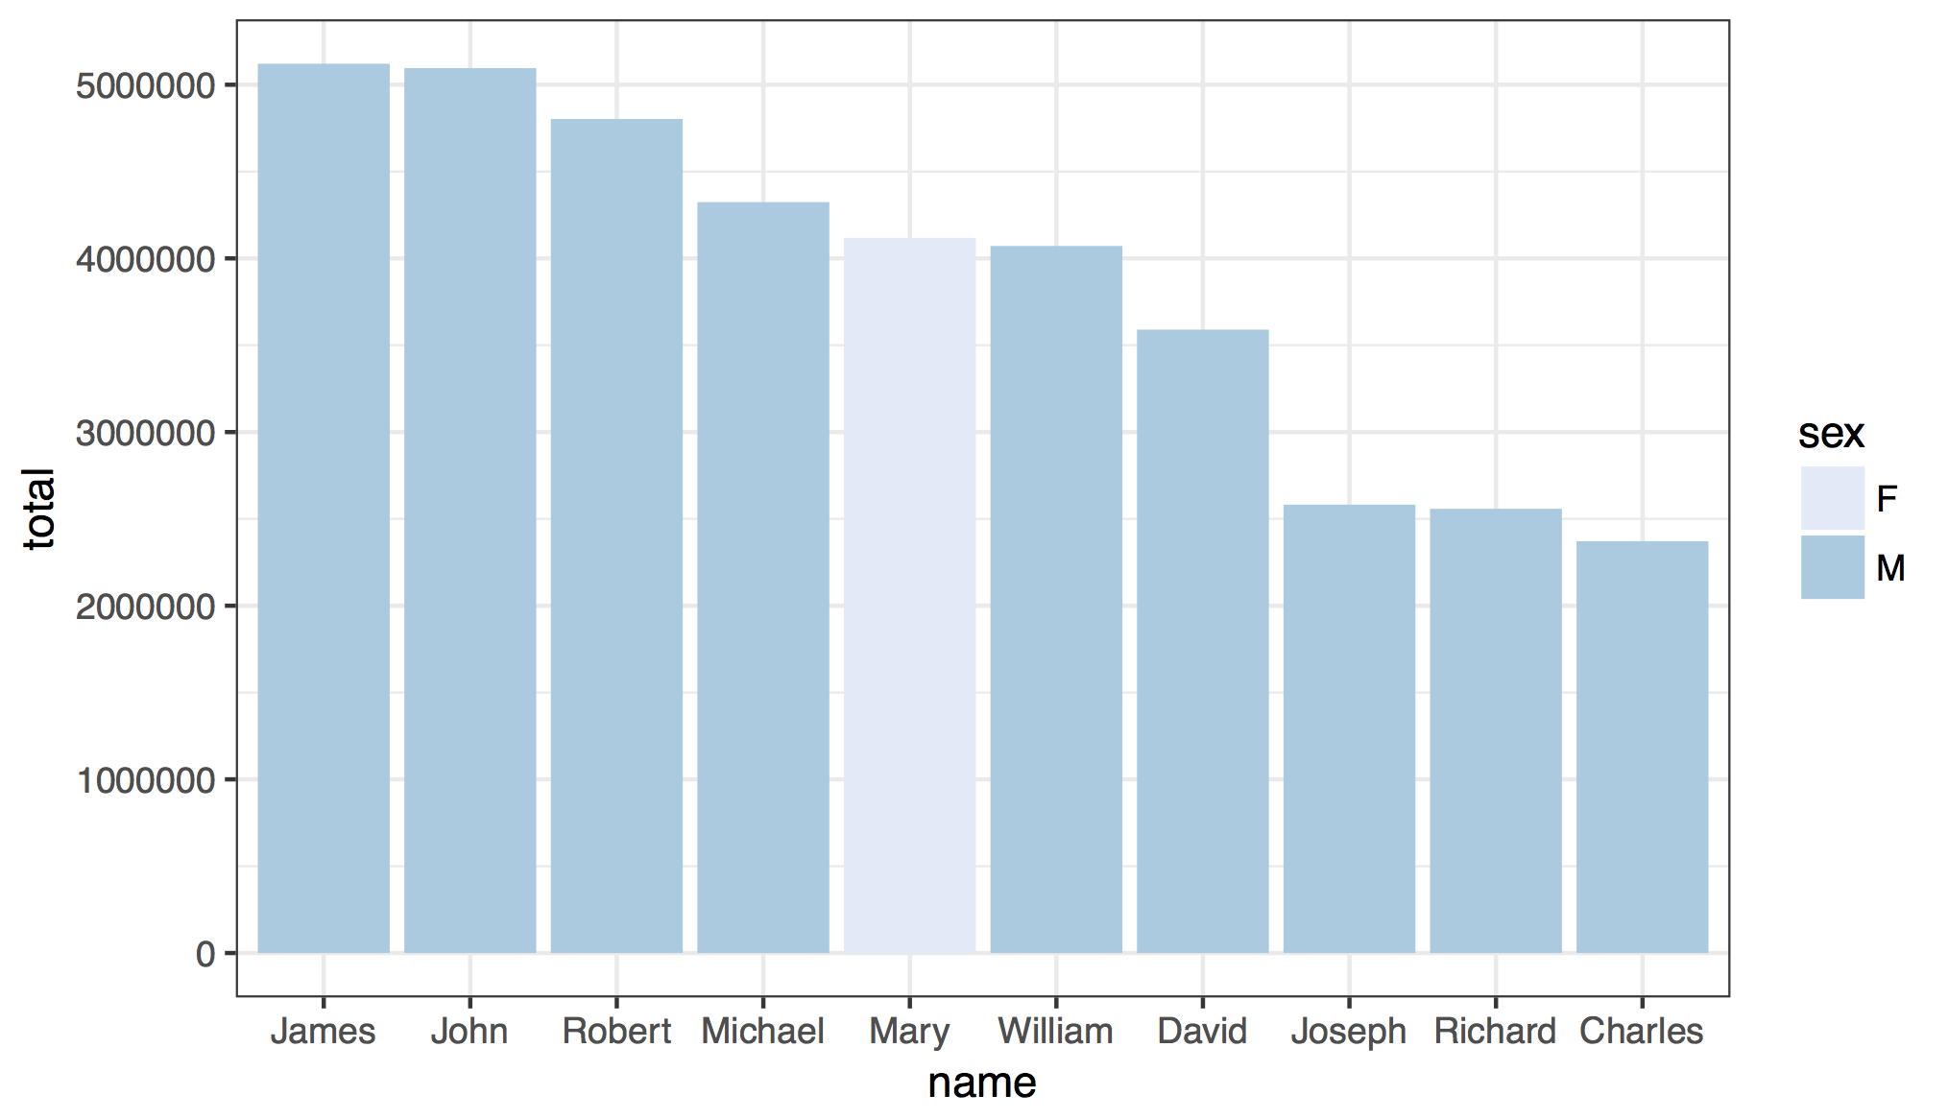

Slide 121
babynames %>%
group_by(name, sex) %>%
summarise(total = sum(n)) %>%
arrange(desc(total)) %>%
ungroup() %>%
slice(1:10) %>%
ggplot() +
geom_col(mapping = aes(x = fct_reorder(name,
desc(total)), y = total, fill = sex)) +
theme_bw() +
scale_fill_brewer() +
labs(x = "name")

Slide 122
babynames %>%
filter(name == "Khaleesi" & sex == "F") %>%
summarise(total = sum(n))
## total
## 1 1964
Can we do this for
each name?

Slide 123
babynames %>%
filter(name == "Khaleesi" & sex == "F") %>%
summarise(total = sum(n))
## total
## 1 1964
babynames %>%
group_by(name, sex) %>%
summarise(total = sum(n)) %>%
arrange(desc(total))

Slide 124

babynames %>%
filter(name == "Khaleesi" & sex == "F") %>%
summarise(total = sum(n))
babynames %>%
group_by(name, sex) %>%
summarise(total = sum(n))
Group by the variables you used to get your test case

Slide 126
How should we define popularity?
A name is popular if:
Sums - a large number of children have the name when you sum across years
Ranks - it consistently ranks among the top names from year to year.
How could this
be biased?

Slide 127
babynames %>%
filter(year == 2017) %>%
summarise(total = sum(n))
## total
## 1 3546301
babynames %>%
filter(year == 1880) %>%
summarise(total = sum(n))
## total
## 1 201484
3,546,301
201,484

Slide 128
Your Turn 9
Use group_by() to calculate the total number of children born for every year.
Plot the results as a line graph: total vs. year.

Slide 129
babynames %>%
group_by(year) %>%
summarise(n_children = sum(n)) %>%
ggplot() +
geom_line(mapping = aes(x = year, y = n_children))

Slide 130
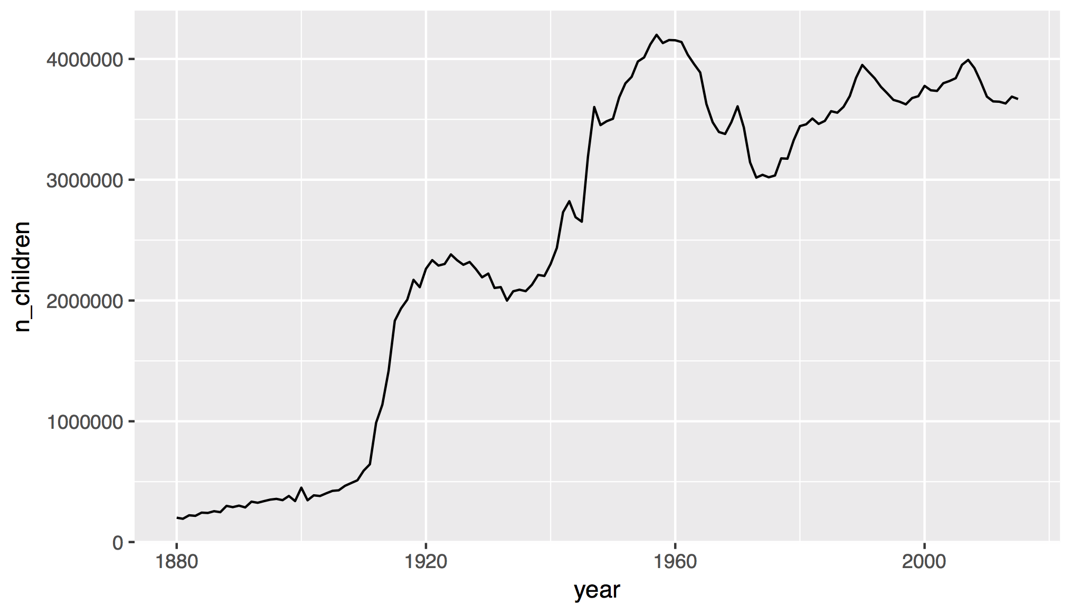

Slide 131
How should we define popularity?
A name is popular if:
Sums - a large number of children have the name when you sum across years
Ranks - it consistently ranks among the top names from year to year.

Slide 132
Quiz
Do we have enough information to:
Rank names within each year?

Slide 133
mutate()

Slide 134
mutate()
Create new columns.
babynames %>%
mutate(percent = round(prop*100, 2))
babynames
year | sex | name | n | prop
1880 | M | John | 9655 | 0.0815
1880 | M | William | 9532 | 0.0805
1880 | M | James | 5927 | 0.0501
1880 | M | Charles | 5348 | 0.0451
1880 | M | Garrett | 13 | 0.0001
1881 | M | John | 8769 | 0.081
1881 | M | William | 8524 | 0.0787
1881 | M | James | 5442 | 0.0503
1881 | M | Charles | 4664 | 0.0431
1881 | M | Garrett | 7 | 0.0001
1881 | M | Gideon | 7 | 0.0001
year | sex | name | n | prop | percent
1880 | M | John | 9655 | 0.0815 | 8.15
1880 | M | William | 9532 | 0.0805 | 8.05
1880 | M | James | 5927 | 0.0501 | 5.01
1880 | M | Charles | 5348 | 0.0451 | 4.51
1880 | M | Garrett | 13 | 0.0001 | 0.01
1881 | M | John | 8769 | 0.081 | 8.1
1881 | M | William | 8524 | 0.0787 | ratio
1881 | M | James | 5442 | 0.0503 | 9.15
1881 | M | Charles | 4664 | 0.0431 | 22.42
1881 | M | Garrett | 7 | 0.0001 | 15.46
1881 | M | Gideon | 7 | 0.0001 | 25.32

Slide 135
mutate()
Create new columns.
babynames %>%
mutate(percent = round(prop*100, 2), nper = round(percent))
babynames
year | sex | name | n | prop
1880 | M | John | 9655 | 0.0815
1880 | M | William | 9532 | 0.0805
1880 | M | James | 5927 | 0.0501
1880 | M | Charles | 5348 | 0.0451
1880 | M | Garrett | 13 | 0.0001
1881 | M | John | 8769 | 0.081
1881 | M | William | 8524 | 0.0787
1881 | M | James | 5442 | 0.0503
1881 | M | Charles | 4664 | 0.0431
1881 | M | Garrett | 7 | 0.0001
1881 | M | Gideon | 7 | 0.0001
year | sex | name | n | prop | percent | nper
1880 | M | John | 9655 | 0.0815 | 8.15 | 8
1880 | M | William | 9532 | 0.0805 | 8.05 | 8
1880 | M | James | 5927 | 0.0501 | 5.01 | 5
1880 | M | Charles | 5348 | 0.0451 | 4.51 | 5
1880 | M | Garrett | 13 | 0.0001 | 0.01 | 0
1881 | M | John | 8769 | 0.081 | 8.1 | 8
1881 | M | William | 8524 | 0.0787 | ratio
1881 | M | James | 5442 | 0.0503 | 9.15
1881 | M | Charles | 4664 | 0.0431 | 22.42
1881 | M | Garrett | 7 | 0.0001 | 15.46
1881 | M | Gideon | 7 | 0.0001 | 25.32

Slide 136
Your Turn 11
Use min_rank() and mutate() to rank each row in babynames from largest n to lowest n.

Slide 137
babynames %>%
mutate(rank = min_rank(desc(prop)))
?

Slide 138
Vectorized functions
Take a vector as input.
Return a vector of the same length as output.
on back

Slide 139
min_rank()
A go-to ranking function (ties share the lowest rank)
min_rank(c(50, 100, 100, 1000))
# [1] 1 2 2 4
min_rank(desc(c(50, 100, 100, 1000)))
# [1] 4 2 2 1

Slide 140
Your Turn 10
Rank the names
Fill in the blanks to rank each name within its year and sex.

Slide 141
babynames %>%
group_by(year, sex) %>%
mutate(rank = min_rank(desc(prop)))
## Groups: year, sex [276]
# year sex name n prop rank
# 1 1880 F Mary 7065 0.0724 1
# 2 1880 F Anna 2604 0.0267 2
# 3 1880 F Emma 2003 0.0205 3
# 4 1880 F Elizabeth 1939 0.0199 4
# 5 1880 F Minnie 1746 0.0179 5
# 6 1880 F Margaret 1578 0.0162 6
# 7 1880 F Ida 1472 0.0151 7
## … with 1,924,655 more rows

Slide 142
babynames %>%
group_by(year, sex) %>%
mutate(rank = min_rank(desc(prop))) %>%
filter(name == "Garrett")
## Groups: year, sex [177]
# year sex name n prop rank
# 1 1880 M Garrett 13 0.000110 505
# 2 1881 M Garrett 7 0.0000646 707
# 3 1882 M Garrett 15 0.000123 469
# 4 1883 M Garrett 13 0.000116 497
# 5 1884 M Garrett 15 0.000122 488
# 6 1885 M Garrett 9 0.0000776 641
## … with 167 more rows

Slide 143
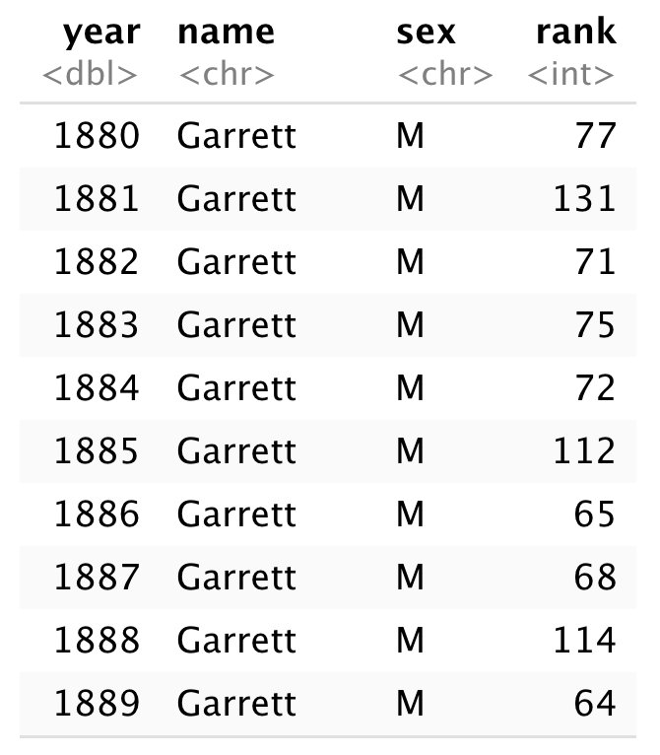
Step 1
Rank the names for each year and sex

Slide 144
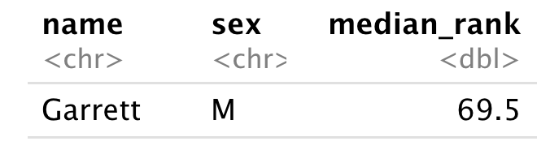
Step 2
Rank the names for each year and sex
Compute the median rank for each name

Slide 145
Strategy
Rank the names for each year and sex
Compute the median rank for each name
Arrange the names by median rank

Slide 146
Strategy
Rank the names for each year and sex
Compute the median rank for each name
Arrange the names by median rank

Slide 147
babynames %>%
group_by(____, ____) %>%
mutate(rank = ____(____(prop))) %>%
group_by(____, ____) %>%
________(score = ______(_____)) %>%
arrange(score)
1
2
3

Slide 148
Your Turn 11
Calculate the medians
Fill in the blanks to compute the median of the ranks for each name (i.e., for each combination of name and sex). Arrange the results from highest median rank to lowest.

Slide 149
babynames %>%
group_by(year, sex) %>%
mutate(rank = min_rank(desc(prop))) %>%
group_by(name, sex) %>%
summarise(score = median(rank)) %>%
arrange(score)
# name sex score
# 1 Mary F 1
# 2 James M 3
# 3 John M 3
# 4 William M 4
# 5 Robert M 6
# … with 107,963 more rows

Slide 150
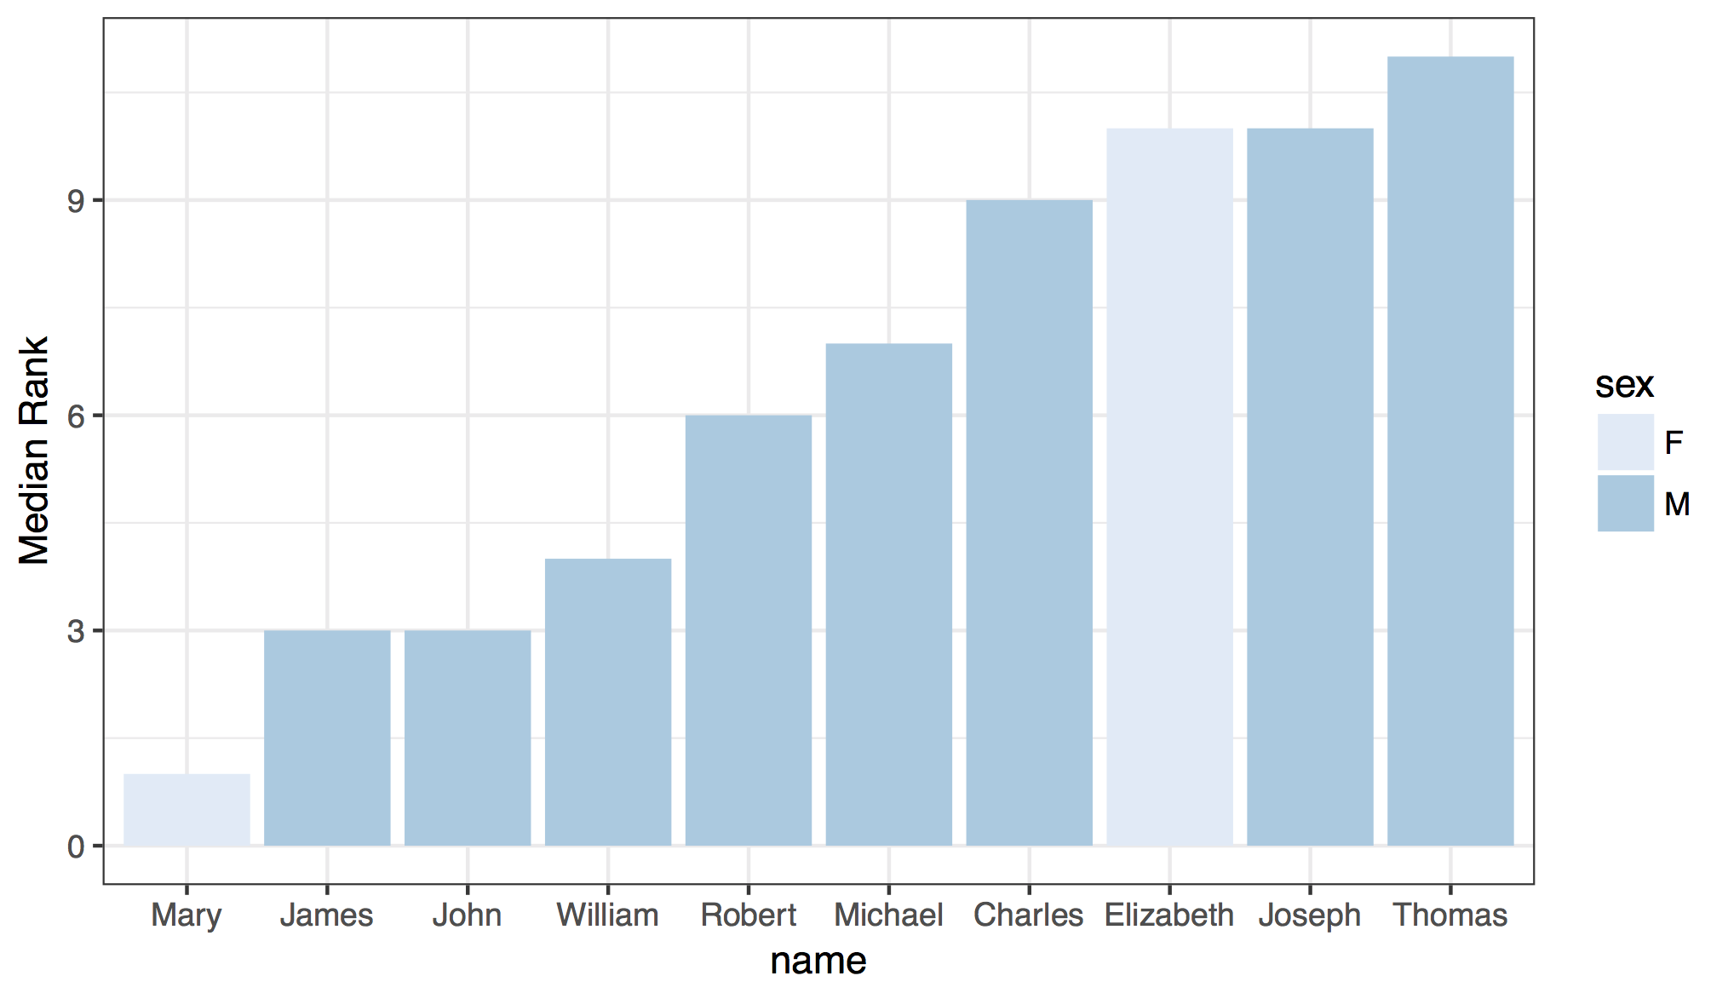

Slide 151
babynames %>%
group_by(year, sex) %>%
mutate(rank = min_rank(desc(prop))) %>%
group_by(name, sex) %>%
summarise(score = median(rank)) %>%
ungroup() %>%
arrange(score) %>%
slice(1:10) %>%
ggplot() +
geom_col(mapping = aes(x = fct_reorder(name, score), y = score,
fill = sex)) +
theme_bw() +
scale_fill_brewer() +
labs(x = "name", y = "Median Rank")

Slide 152
Recap: Single table verbs
storm | wind | pressure | date
Alberto | 110 | 1007 | 2000-08-12
Alex | 45 | 1009 | 1998-07-30
Allison | 65 | 1005 | 1995-06-04
Ana | 40 | 1013 | 1997-07-01
Arlene | 50 | 1010 | 1999-06-13
Arthur | 45 | 1010 | 1996-06-21
storm | pressure
Alberto | 1007
Alex | 1009
Allison | 1005
Ana | 1013
Arlene | 1010
Arthur | 1010
Extract variables with select()
date | wind | date | date
2000-08-12 | 110 | 2000-08-12 | 2000-08-12
1998-07-30 | 45 | 1998-07-30 | 1998-07-30
1880 | M | Garrett | 13
1997-07-01 | 40 | 1997-07-01 | 1997-07-01
1880 | M | Garrett | 13
1996-06-21 | 45 | 1996-06-21 | 1996-06-21
date | wind | date | date
1880 | M | Garrett | 13
1880 | M | Garrett | 13
Extract cases with filter()
storm | wind | pressure | date
Alberto | 110 | 1007 | 2000-08-12
M | M | M | M
Allison | 65 | 1005 | 1995-06-04
Ana | 40 | 1013 | 1997-07-01
Arlene | 50 | 1010 | 1999-06-13
M | M | M | M
storm | wind | pressure | date
Ana | 40 | 1013 | 1997-07-01
M | M | M | M
M | M | M | M
Arlene | 50 | 1010 | 1999-06-13
Allison | 65 | 1005 | 1995-06-04
Alberto | 110 | 1007 | 2000-08-12
Arrange cases, with arrange().
storm | wind | pressure | date
Alberto | 110 | 1007 | 2000-08-12
Alex | 45 | 1009 | 1998-07-30
Allison | 65 | 1005 | 1995-06-04
Ana | 40 | 1013 | 1997-07-01
Arlene | 50 | 1010 | 1999-06-13
Arthur | 45 | 1010 | 1996-06-21
Allison | Allison
13 | 13
Make tables of summaries with summarise().
storm | wind | pressure | date
Alberto | 110 | 1007 | 2000-08-12
Alex | 45 | 1009 | 1998-07-30
Allison | 65 | 1005 | 1995-06-04
Ana | 40 | 1013 | 1997-07-01
Arlene | 50 | 1010 | 1999-06-13
Arthur | 45 | 1010 | 1996-06-21
storm | wind | pressure | date | ratio
Alberto | 110 | 1007 | 2000-08-12 | 9.15
Alex | 45 | 1009 | 1998-07-30 | 22.42
Allison | 65 | 1005 | 1995-06-04 | 15.46
Ana | 40 | 1013 | 1997-07-01 | 25.32
Arlene | 50 | 1010 | 1999-06-13 | 20.20
Arthur | 45 | 1010 | 1996-06-21 | 22.44
Make new variables, with mutate().

Slide 153
$

Slide 154

select()
Extract columns by name.
select(babynames, n)
babynames
year | sex | name | n | prop
1880 | M | John | 9655 | 0.0815
1880 | M | William | 9532 | 0.0805
1880 | M | James | 5927 | 0.0501
1880 | M | Charles | 5348 | 0.0451
1880 | M | Garrett | 13 | 0.0001
1881 | M | John | 8769 | 0.081
1881 | M | William | 8524 | 0.0787
1881 | M | James | 5442 | 0.0503
1881 | M | Charles | 4664 | 0.0431
1881 | M | Garrett | 7 | 0.0001
1881 | M | Gideon | 7 | 0.0001
n
9655
9532
5927
5348
13
8769
8524
5442
4664
7
7
Still a dataframe

Slide 155
$
Extract column contents as a vector.
babynames$n
babynames
year | sex | name | n | prop
1880 | M | John | 9655 | 0.0815
1880 | M | William | 9532 | 0.0805
1880 | M | James | 5927 | 0.0501
1880 | M | Charles | 5348 | 0.0451
1880 | M | Garrett | 13 | 0.0001
1881 | M | John | 8769 | 0.081
1881 | M | William | 8524 | 0.0787
1881 | M | James | 5442 | 0.0503
1881 | M | Charles | 4664 | 0.0431
1881 | M | Garrett | 7 | 0.0001
1881 | M | Gideon | 7 | 0.0001
9655 9532 5927 5348 …

Slide 156
$
Extract column contents as a vector.
babynames$n
data frame
$
column name (no quotes)

Slide 157
pull()
Pipe friendly version of $
babynames %>% pull(n)
babynames
year | sex | name | n | prop
1880 | M | John | 9655 | 0.0815
1880 | M | William | 9532 | 0.0805
1880 | M | James | 5927 | 0.0501
1880 | M | Charles | 5348 | 0.0451
1880 | M | Garrett | 13 | 0.0001
1881 | M | John | 8769 | 0.081
1881 | M | William | 8524 | 0.0787
1881 | M | James | 5442 | 0.0503
1881 | M | Charles | 4664 | 0.0431
1881 | M | Garrett | 7 | 0.0001
1881 | M | Gideon | 7 | 0.0001
9655 9532 5927 5348 …

Slide 158
Transform Data with

